Slide 1


“Capstone Project”
Submitted by: Omkar Sunil Kulkarni
Submission type : Individual
Name: Omkar Sunil Kulkarni
Batch : HDFC(API Developer)
LMS Id : omkar6425@gmail.com
Guided By : Javeed Sir
Date: 10/05/2023

Slide 2

Table of contents
Introduction
Project Overview
Architecture Design
Back-end Development Steps
Deployment
Conclusion
Future Work
References
Appendices

Slide 3
Introduction
Project Title : Employee Management Project
Problem Statement : To find the way to access the employee data from the database just by specifying the employee id.
Research Question : To find the way to secure the HTTP request using SSL certification.
Objective : The main objective of the application is to retrieve the data from the database just by specifying the employee id where the employee date of birth is in encrypted format and to create a Jenkins pipeline to build and push the image to Docker hub, also deploy application to Kubernetes.

Slide 4
Project Overview
Functionality :
To fetch the employee data by entering valid employee id
Encryption of Date Of Birth
To create a secure API request that is configured with self-signed certificate.
Integration and Docker deployment with Jenkins.
Deployment to Kubernetes.
Technology Stack :
Spring Boot Application : To create spring boot application with all required dependencies.
MYSQL Database : To create a employee database for storing the employee data.
Postman : To test aur API.
Jenkins : For continuous integration with git repository and building the docker image.
Docker : To run the created containers.
Kubernetes : For Deployment Purpose.

Slide 5
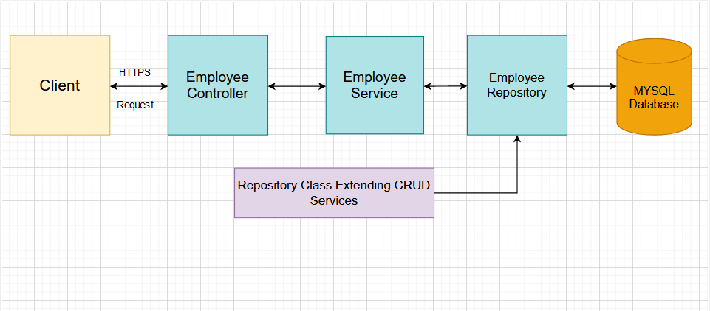
Architecture Design

Slide 6
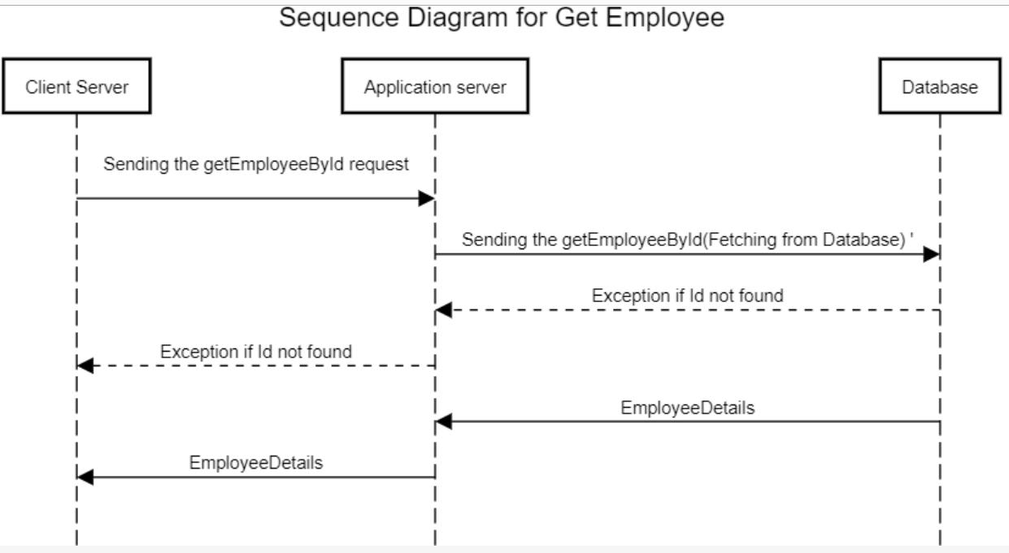
Architecture Design

Slide 7
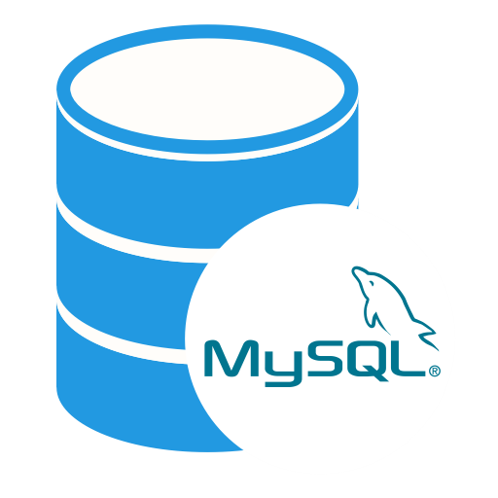



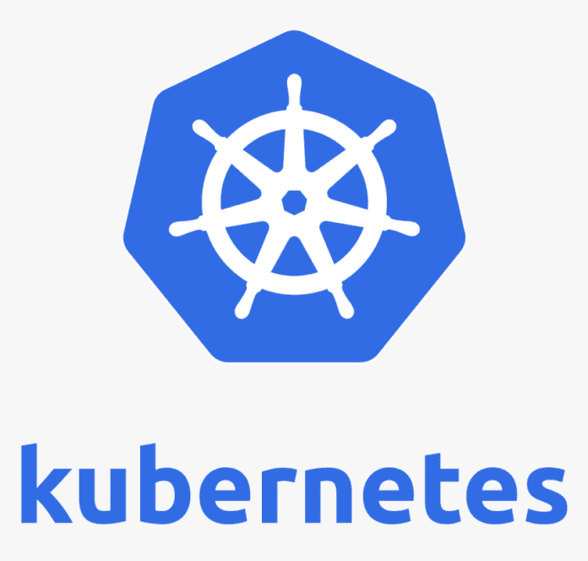
Back-end Development Steps
Database Setup
Java Code Development
Web Service Development
Client Program for the Web Service
Security Implementation
Containerization and Deployment

Slide 8
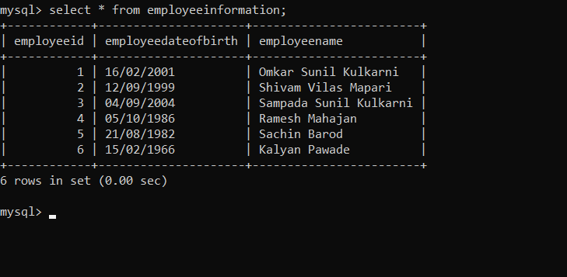
Back-end Development
Database Setup
To Create a table Employee with 3 columns (EmployeeID, EmployeeName, DateOfBirth) in a database.
To Write SQL queries to insert, update and delete records from the Employee table.
Use a database management tool like MySQL Workbench to manage and monitor the Employee table.
Ensure that the Employee table is connected to the Java code for querying.
We can also use Spring Data JPA’s repository feature , which can easily connect to our Java application with database.

Slide 9
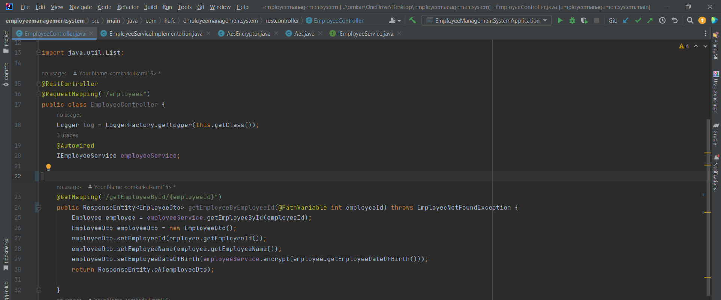
Back-end Development
Java Code Development
Writing Java code to fetch a single record based upon EmployeeID.
Using Springboot or an Application server such as Tomcat, WebLogic, etc. to run the code.
Returning an Invalid EmployeeID Error if EmployeeID is not matched.
Check the code into a repository such as GIT or equivalent.

Slide 10
Back-end Development
Web Service Development
Modify the Java (or equivalent) code so that it is exposed as a HTTP web service.
Accept a single EmployeeID in the request and return all three fields of that Employee in the response.
Print a log file with date-timestamp for every time the web service is called.
Rotate the log file if the size exceeds 1MB i.e., backup the existing file and create a new log file.

Slide 11
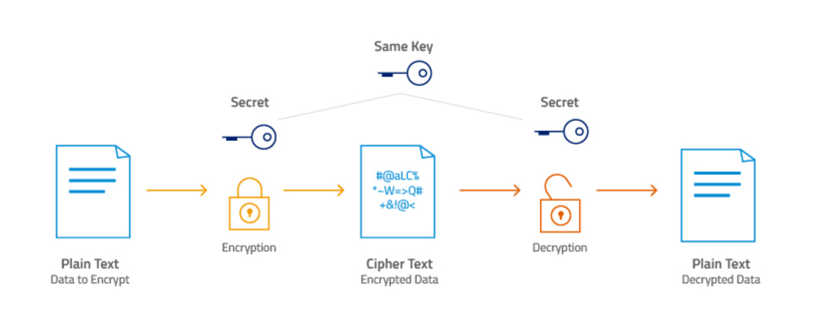
Back-end Development
Client Program for the Web Service
To Write a separate Java (or equivalent) client program to call this web service.
Update the code of the web service so that DateOfBirth is encrypted using AES-256.
Update the client program to decrypt this encrypted value.

Slide 12
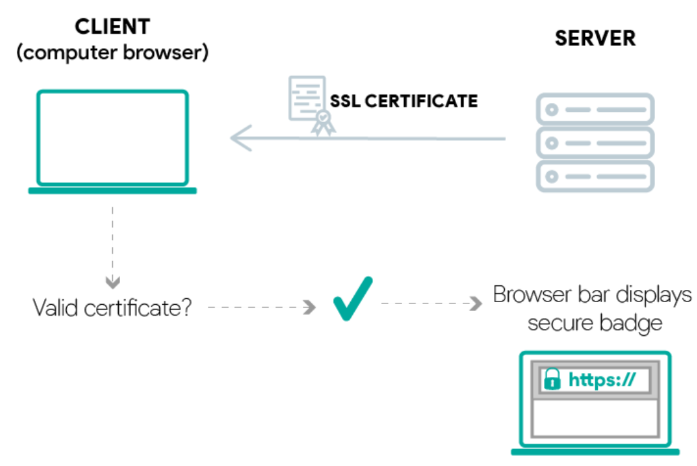
Back-end Development
Security Implementation
Change the web service to be exposed as HTTPS and not HTTP.
Use a self-signed certificate for secure communication.
Test the web service using Postman and CURL command.
Encrypt the DateOfBirth using AES-256 and update the web service code.

Slide 13
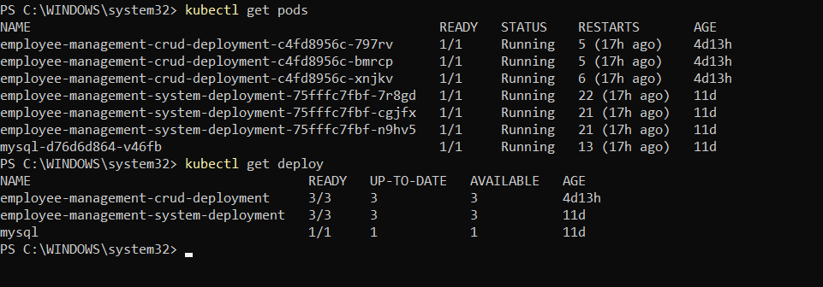
Back-end Development
Containerization and Deployment
Create a containerized version of the web service.
Deploy the container on Kubernetes with 3 instances of the web service running.
Test the containerized web service using the same/similar client program.
Monitor the containerized web service using tools like Kubernetes Dashboard or Prometheus.

Slide 14

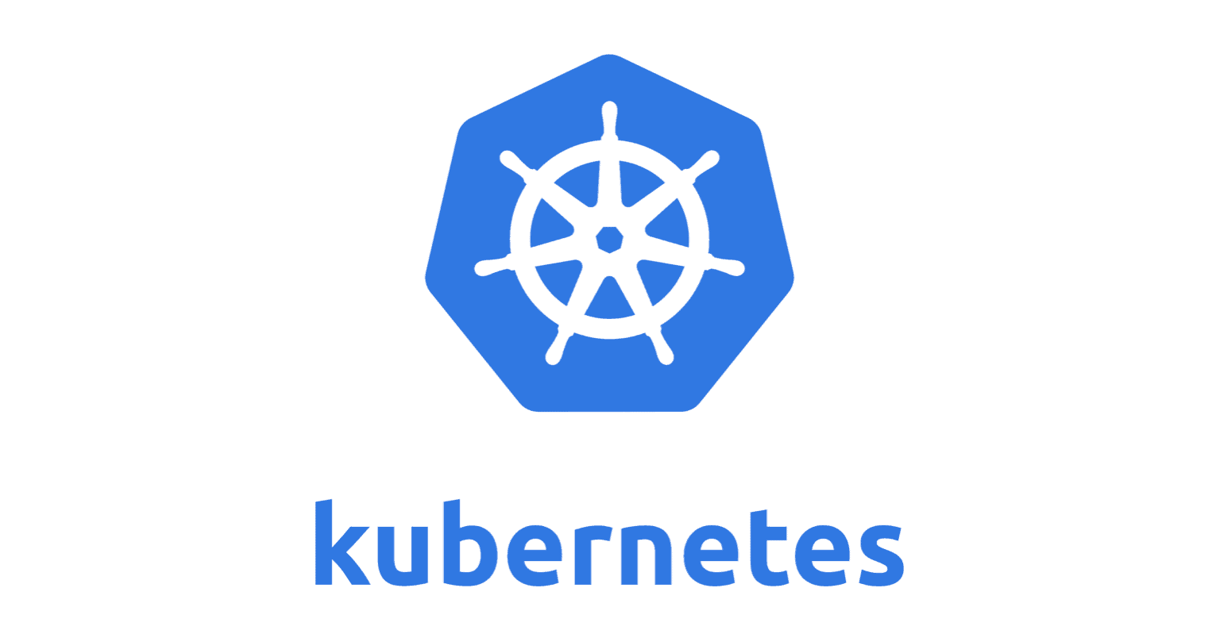




Deployment
Build Gradle Project
Commit code
Build Docker Image
Deployment to kubernetes
Push Docker Image
Developer

Slide 15
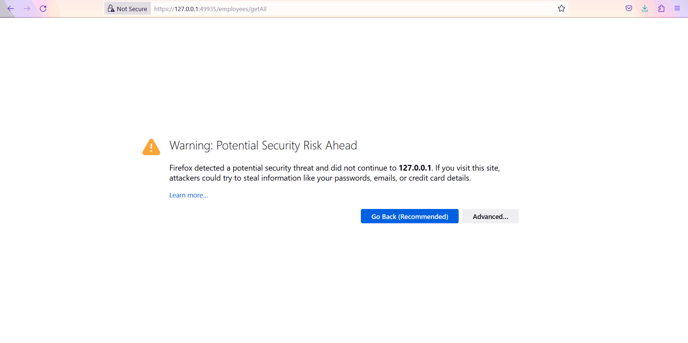
Integration and Testing
Testing for Secure HTTPS Protocol

Slide 16
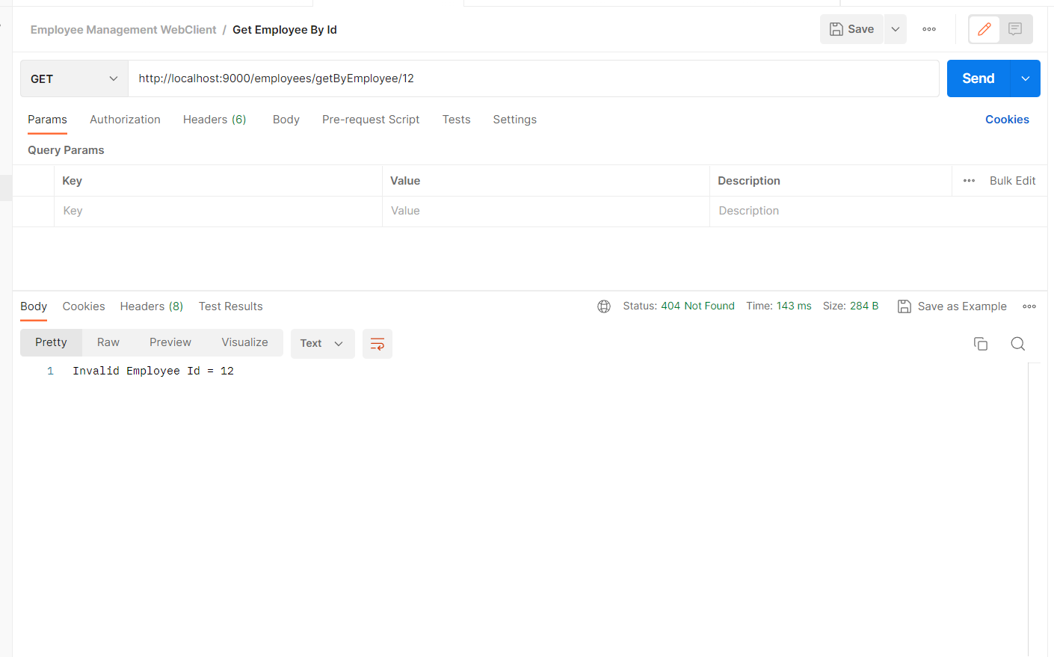
Integration and Testing
Testing if user enters Invalid Employee Id

Slide 17
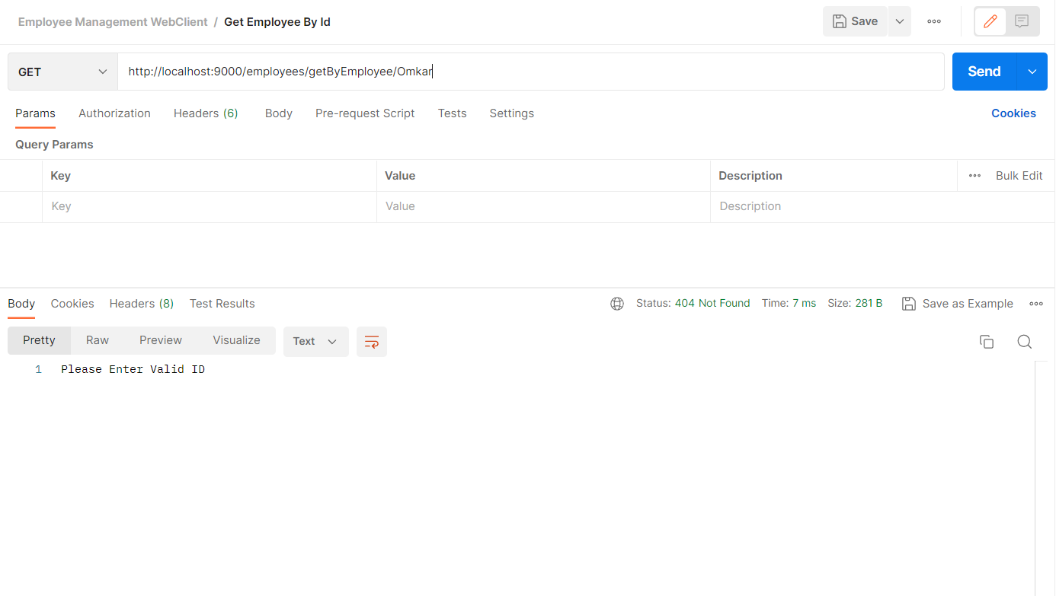
Integration and Testing
Testing if user enter other than Employee Id

Slide 18
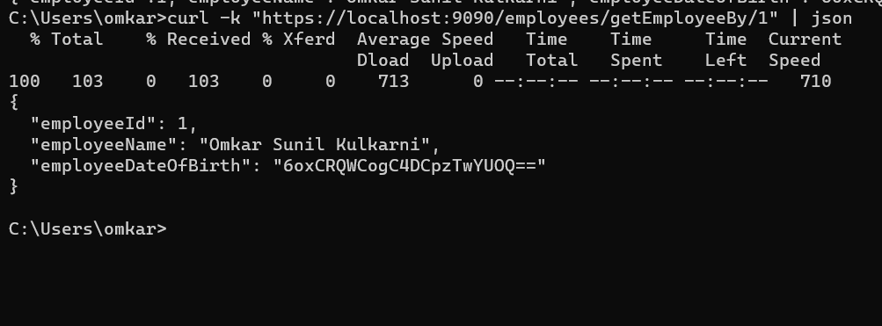
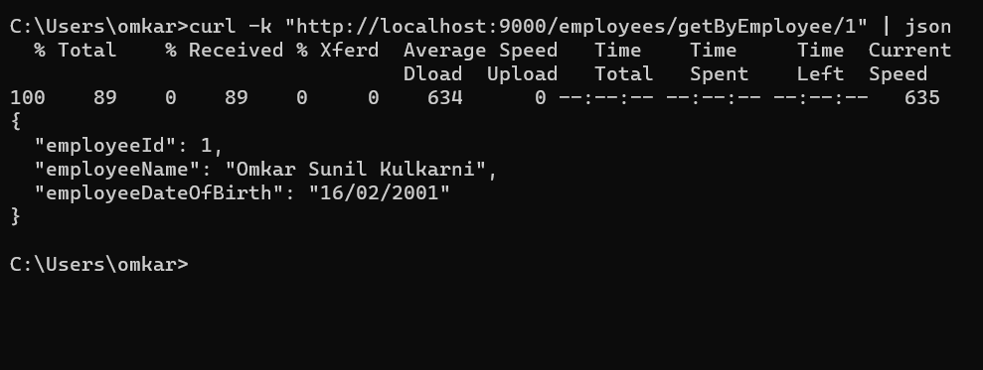
Integration and Testing
Testing using CURL COMMAND

Slide 19
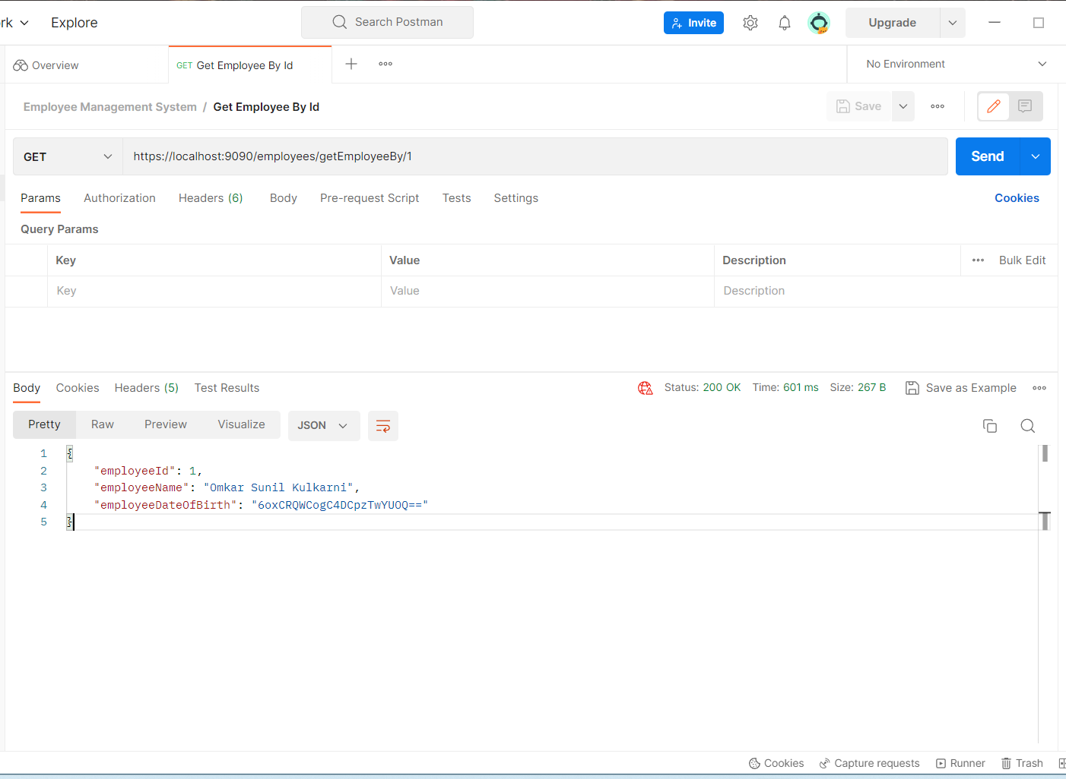
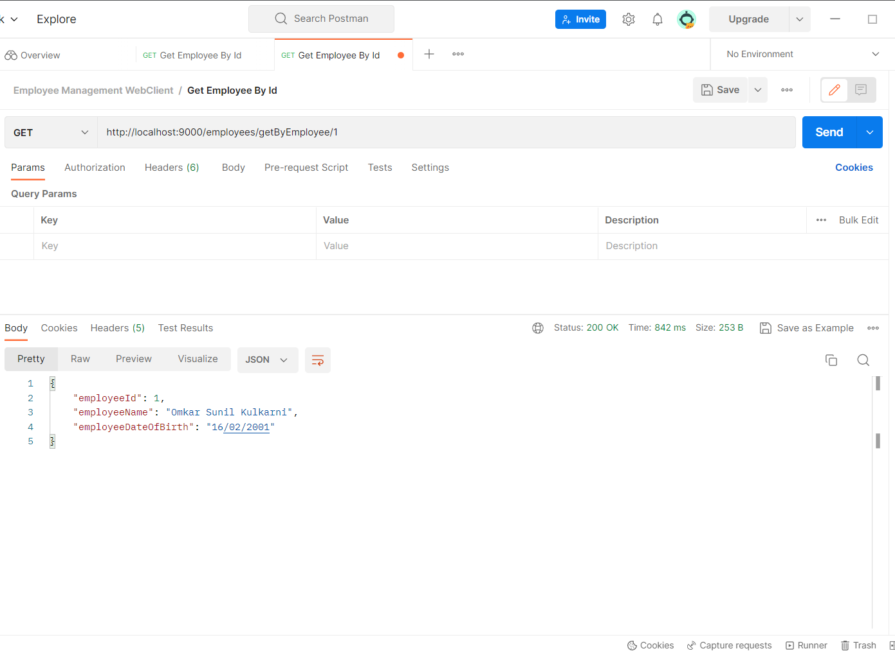
Integration and Testing
Testing Encryption and Decryption in Response

Slide 20
Conclusion
This project showcases the power and flexibility of using SpringBoot, RestController, and Kubernetes together to create a secure and efficient API for accessing employee data
This project demonstrates the benefits of using modern technologies and best practices for building APIs, such as using containerization, automation, and security measures
Automation using Jenkins and Docker simplifies the build and deployment process, improves the consistency and quality of the application, enables faster and more frequent deployments, and provides greater flexibility and scalability.

Slide 21
Future Work
Implementing User Interface :- The current application is designed as backend part but in future we can use technology like React etc to create a UI design which would be interactive easily used by users.
Implementing With Different Database : As our application now uses MySQL database in future we could try connecting with other database like Mongo DB , PostgreSQL etc.
Implementing SonarQube : We can do continuous inspection of code quality to perform automatic reviews with static analysis of code to detect bugs and code smells.

Slide 22
References
StackOverflow : https://stackoverflow.com/questions/6865538/solving-a-communications-link-failure-with-jdbc-and-mysql
Youtube Link : https://www.youtube.com/watch?v=adG0vq5boL8
StackOverflow : https://stackoverflow.com/questions/56083444/invoke-gradle-in-jenkins-pipeline
Google : https://www.google.com/
AES-256 Encryption and Decryption
https://www.baeldung.com/java-aes-encryption-decryption
https://howtodoinjava.com/java/java-security/aes-256-encryption-decryption/

Slide 23
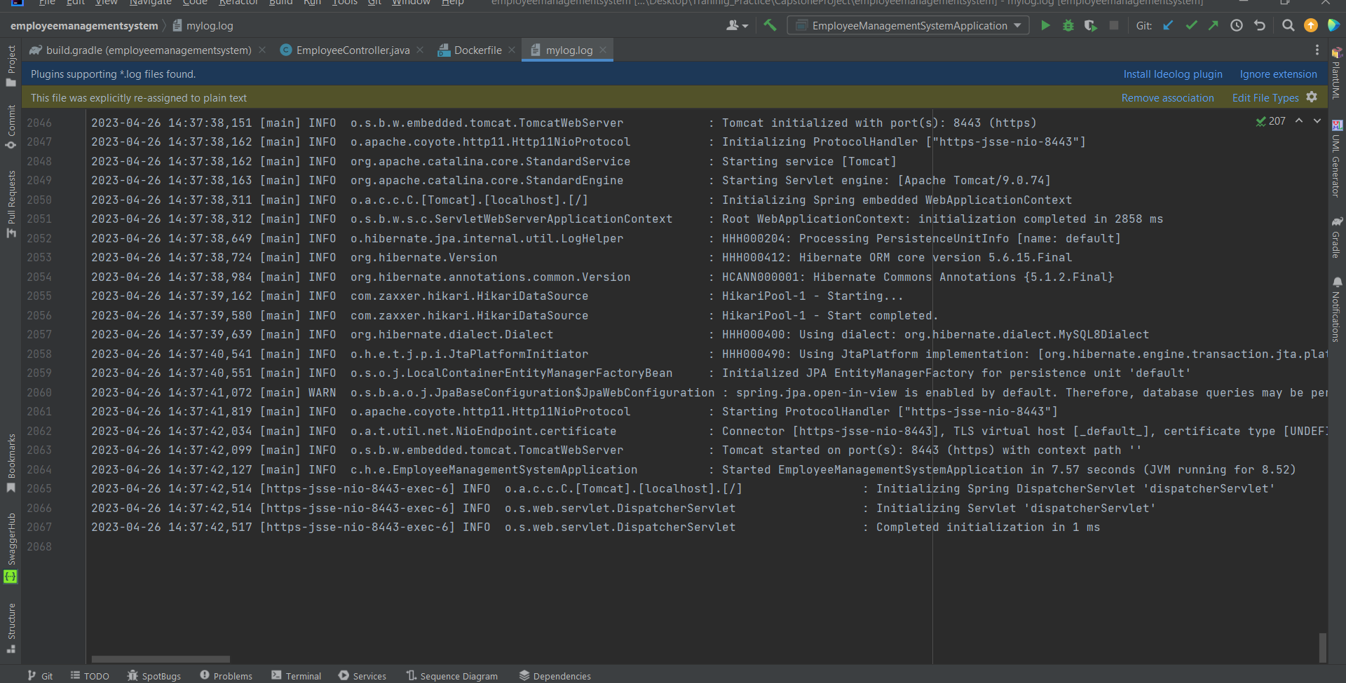
Appendices
1)Log file

Slide 24
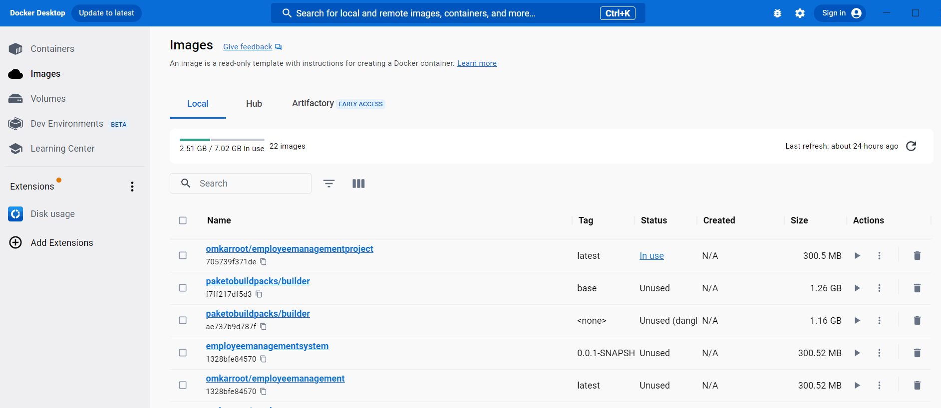
Appendices
2)Docker Image Creation

Slide 25
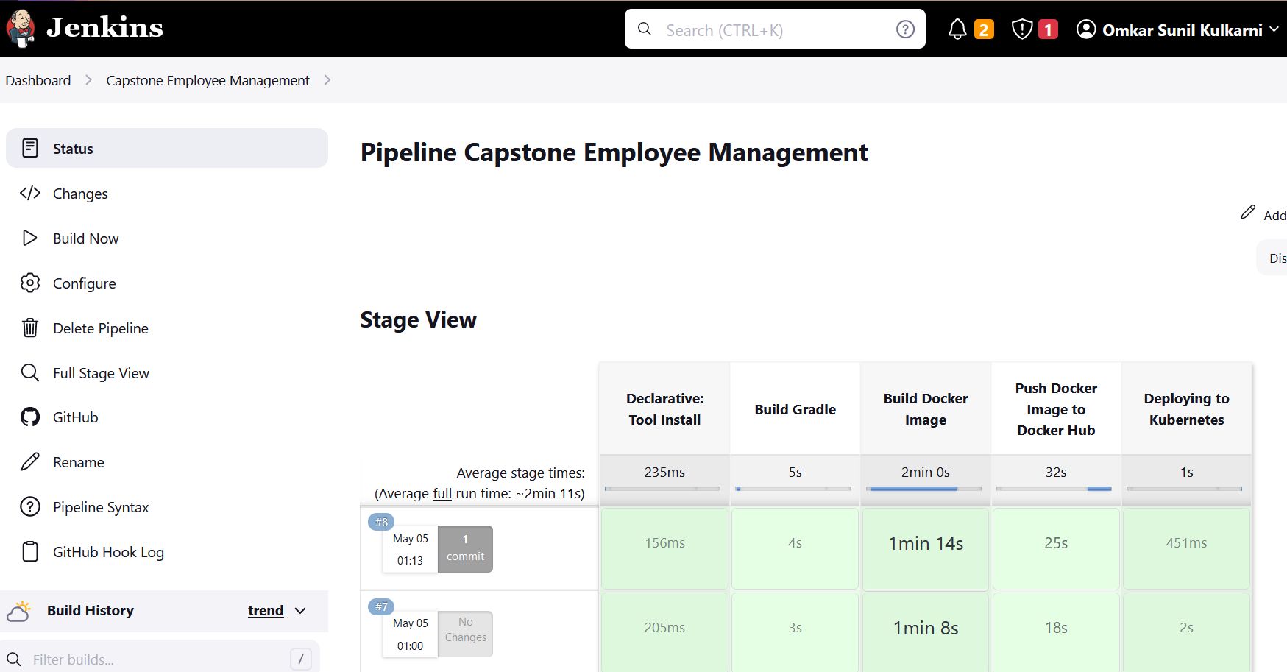
Appendices
3)Jenkins Pipeline

Slide 26


